Slide 1
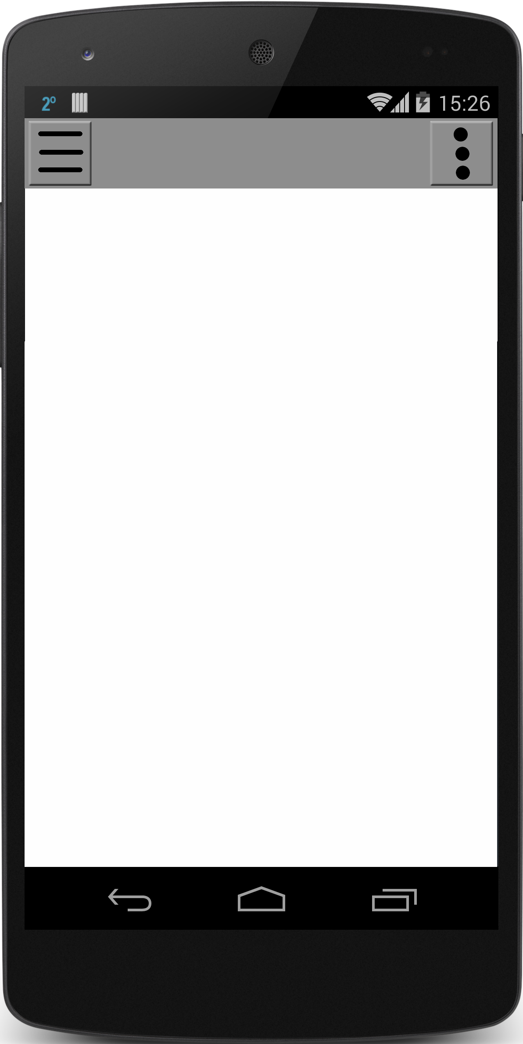
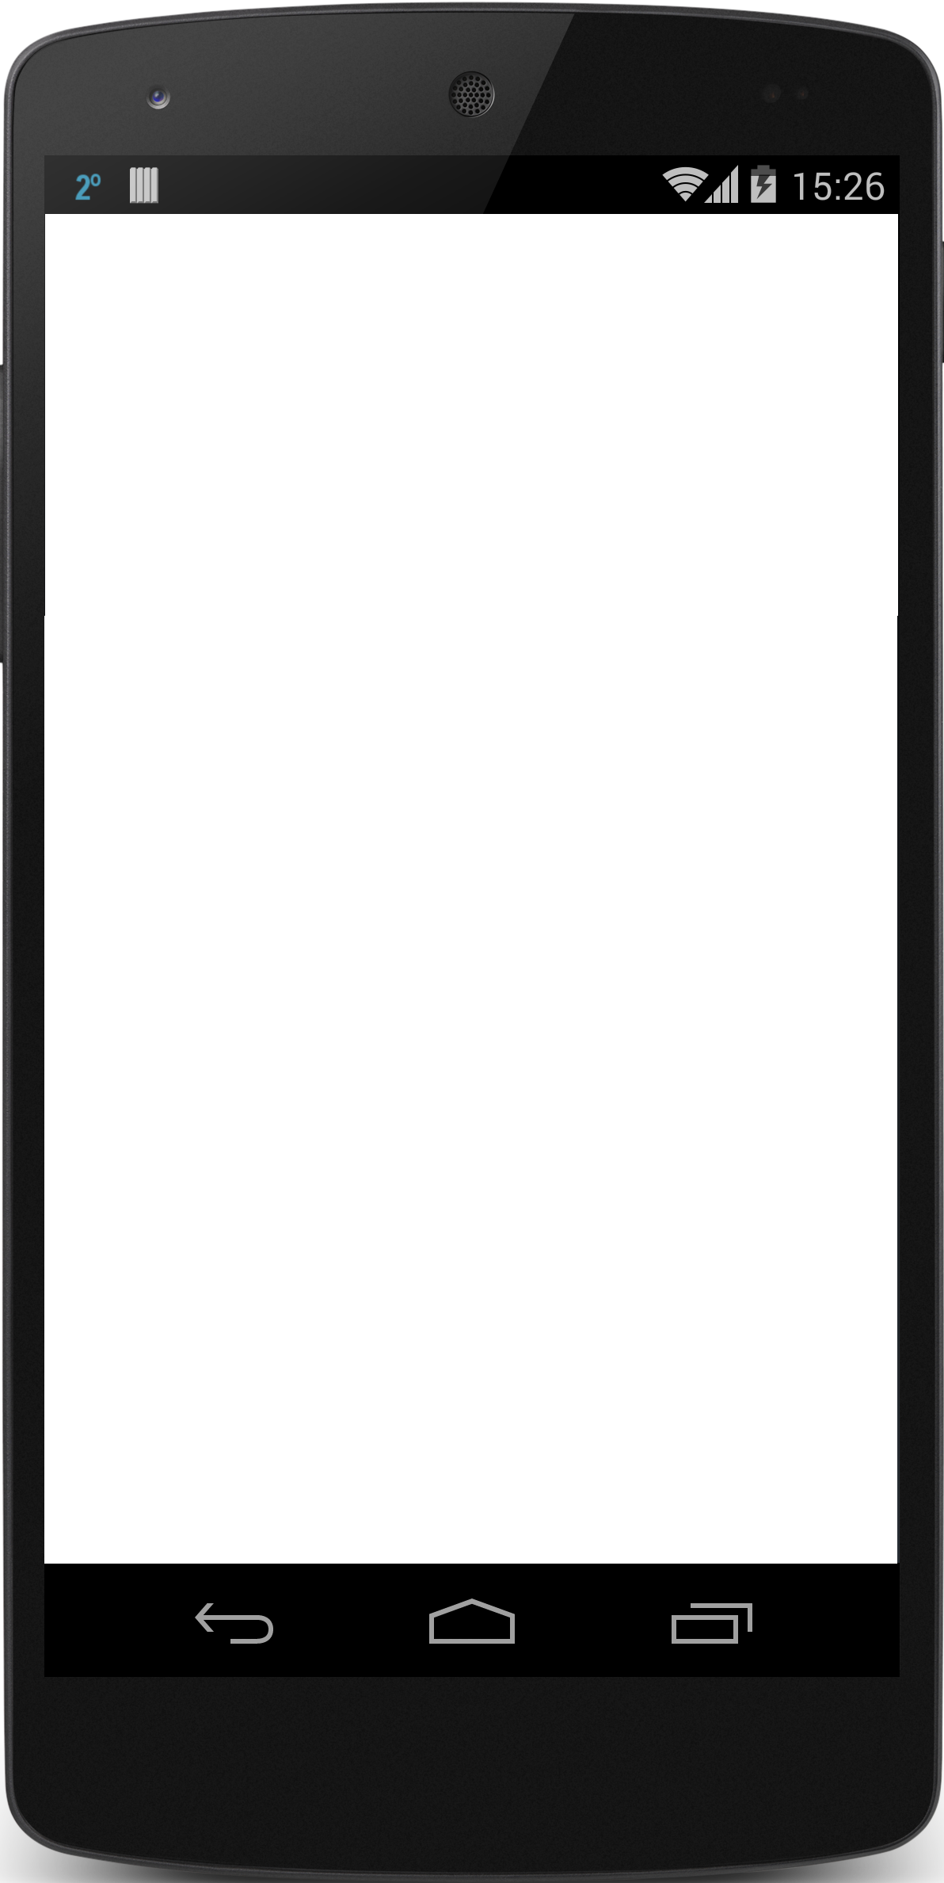

Notes:
TEMPLATES

Slide 2
Login Page
Username
Password
LOGIN
Facebook
Google
Register
Forgot Password

Slide 3
Register Page
Username
First Name
Last Name
Email
Phone Number
Zip-Code
Password
Confirm Password
Accept User Agreement
Register
Cancel
Notes:
Need to check against existing usernames

Slide 4
Reset
Password
Page
Password Reset
*Enter Email Phone Number Or Username
Submit
Cancel
Notes:
Can throw an error under the text field if the user doesn’t exist
Will parse automatically the texts inputted

Slide 5
Change
Password
Page
Password Change
Verification Code
New Password
Confirm Password
Submit
Cancel
Notes:
Can throw an error under the text field if the user doesn’t exist
Will parse automatically the texts inputted

Slide 6




NAV
Menu
Settings
Map
List
Home
Map-View
Add Game
Notes:
Shows a map containing the games in a certain area with an icon to match the description

Slide 7
NAV
Menu
Settings
Map
List
Search
Filter
V
Results: 4
Home
List-View
Basketball Game
South Park (3 miles)
3/6
10:00am – 12:00pm
Tennis
North Park (4 miles)
1/2
3:00pm – 4:30pm
# of players/ total
Big Soccer Game
7/10
East Park (3.75 miles)
6:00pm – 8:00pm
Basketball Game
The Y (2 miles)
4/15
6:00am – 7:00pm
Add Game
Notes:
Shows a map containing the games in a certain area with an icon to match the description

Slide 8
Game
Creation
View

Slide 9
Game Title
Captain: Mike Jones
Location: North Park
Time: 12:00pm – whenever
Pop up (“joined”)
Button changes to
”Leave Game”
Players: 3/6
Game
View
Description:
We want to get a game of 3 on 3 together
around noon. Any skill level is welcome.
JOIN GAME
Mike Jones
Hey everyone message
here if you want in.
Random Dude
I am so down. Do we need to bring anything
Message here
>
Notes:
Add list of items to bring button (checklist of game items)
We will need an edit view for this screen as well

Slide 10




SuperBaller76
SuperBaller76
Age: 17
Age: 17
Edit
Zip: 50266
Zip: 50266
Edit
10
Gender: Male
Gender: Male
Edit
1
Last Active:
01/20/2016
Friend
View
Games: 3
User
View
Bio:
I like basketball, football, baseball, and magic the gathering.
Add Friend
Message Me
Edit
Achievements
Notes:
Add Last Games Played in as well

